Slide 1


Neural Network Models for Object Recognition
University: University of Essex Online
Module: Machine Learning
Unit 11: Neural Network models for object recognition
Team members: Samuel Adeniyi, Rachel Mead and Konstantinos Kyriacou

Slide 2
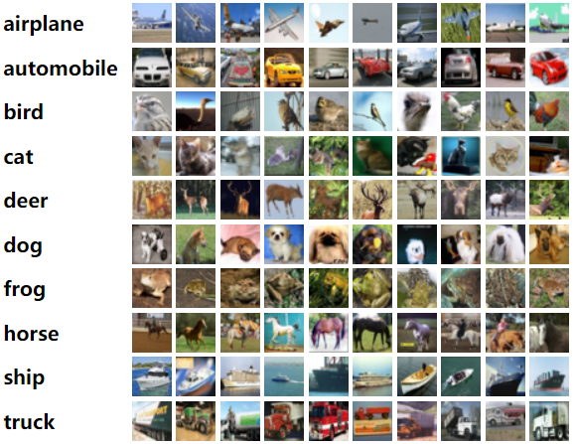
The Dataset-CIFAR10
The dataset consists of 60,000 images, each belonging to one of the following ten categories: ‘airplane’, ’automobile’, ’bird’, ‘cat’, ’deer’, ‘dog’, ‘frog’, ‘horse’, ‘ship’ and ‘truck’. Thus, there are 6,000 images per category (Canadian Institute for Advanced Research, 2009)

Slide 3
OBJECTIVES
OBJECTIVES
Build a Convolutional Neural Network using the CIFAR-10 dataset
Evaluate the performance of the convolutional neural network
Build a model with sufficiently high performance to enable each image to be classified correctly, according to their respective category

Slide 4
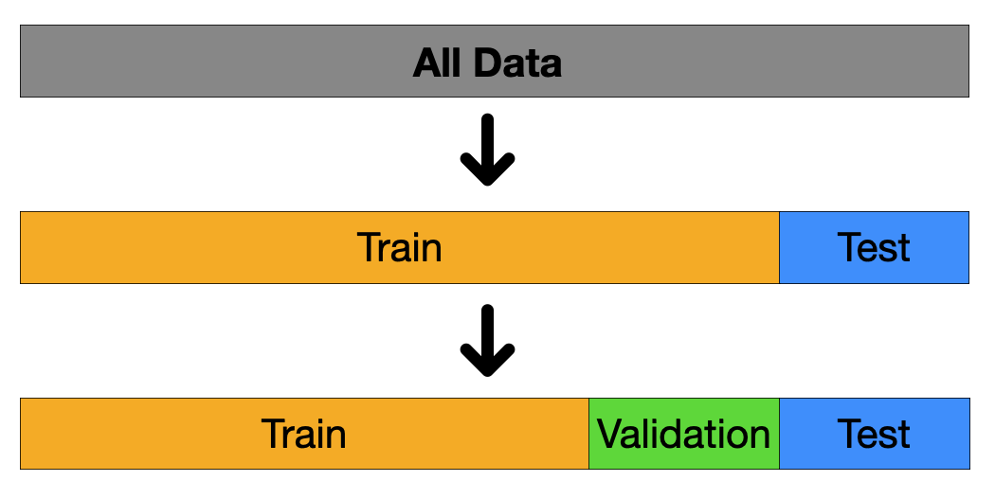
TRAINING AND VALIDATION SET
TRAINING SET:
Train the model
Provide the best fit of the model
Improve the prediction rate when predicting the test samples
VALIDATION SET:
Select the initial 10,000 records of the training set to be utilized for our validation procedure

Slide 5
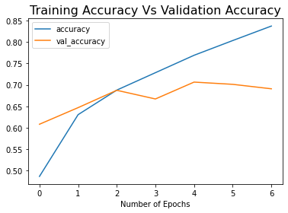
Training measures vs validation measures
TRAINING MEASURES
The training loss demonstrates the measure of deviation of the model from the training data
The validation loss demonstrates the measure of deviation of the model when fitting new data (Yathish, 2022)
VALIDATION MEASURES
The training accuracy demonstrates the measure of accuracy of the model on the training data
The validation accuracy demonstrates the measure of accuracy when modelling new data

Slide 6
Validation Set
Review the performance of the model on new data based on different combinations of hyperparameters, thus to proceed to the best choice of modelling for predicting the test data
Prevent the model from overfitting, meaning that the model performed well in classifying the training data but, on the other hand, was not able to make accurate predictions with data that was as yet unseen by the model

Slide 7
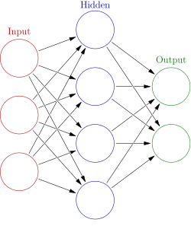
The Structure of ANN
ADVANTAGES
Gives the ability of the Artificial Neural Network to extract the feature of the input more efficiently
Improves the performance of the model
Allows for parallel processing and for more efficient computation
Has the ability to adjust and provides great learning potential
DISADVATAGES
It is computationally costly
The potential for overfitting is greater in comparison to other modelling structures

Slide 8
Activation functions
ReLU
SoftMax
Advantages:
The output of the function is not linear which increases the accuracy of the model
Train faster the model
Less computationally expensive
Disadvantages:
Some neurons may stop responding to variations in error or input along the process of modelling (DanB, 2018)
Advantages:
Contribute in determining the final decision as regards the classification of the image
Weight the max logit significantly greater than the rest logits (Wood, N.D.)

Slide 9
Categorical cross entropy loss function
Advantages
Disadvantages
Easy to implement and optimize
The graphical representation of the function consists of a smooth and convex shape (Koech, 2020; Kumar, 2020)
It is not affected when scaling or shifting of the predicted probabilities if the probabilities values still range between 0 and 1 (LinkedIn, 2023)
Sensitive to outliers or imbalanced data
The accuracy of the model performance is not indicated directly (Brownlee, 2019)

Slide 10
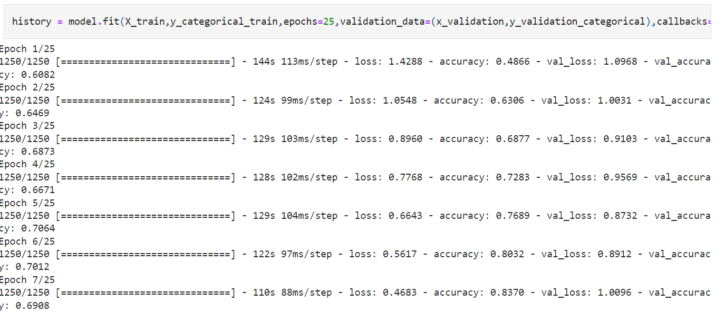
Number of epochs utilised
25 epochs were selected to train our model and thus improve its performance for every subsequent iteration.
Constraint: When the model performance reaches a point where the outcome of the cross-entropy loss function for the validation data remains the same for the two subsequent cycles then we conclude that our model has reached at a satisfactory level of performance and thus the training should stop at that point. Consequently, the model training process performs only the initial 7 iterations until it reaches that point, thus the rest cycles are omitted.

Slide 11
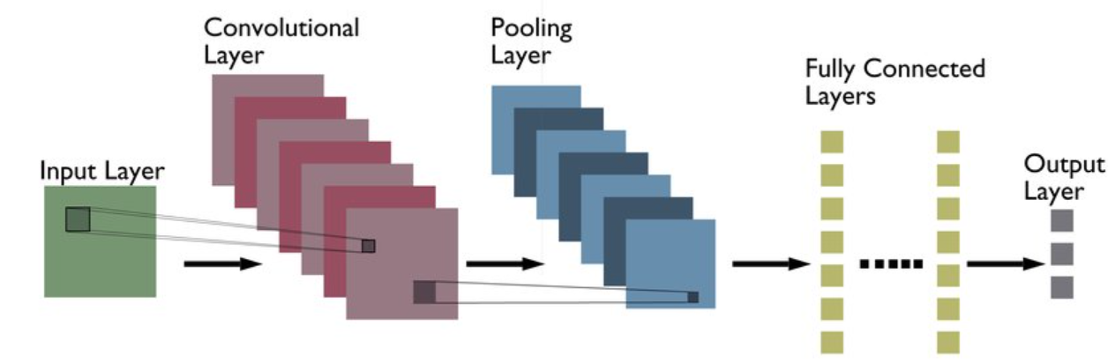
Neural Network design
During the initial phase of modelling, double sets of layers are constructed, each one consisting of a convolutional layer and a pooling layer
The convolutional layer is utilized to extract several features from the input image. Following that, the output becomes the input of the following pooling layer whose primary aim is to reduce the size of the convolved feature map and thus reduce the computational costs (Kumar, 2021)

Slide 12
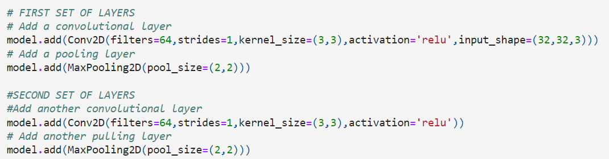
Neural network design
Convolutional Layer
The input shape consists of three dimensions which are equal to 32 x 32 x 3
The length and width of the kernel are both chosen to be equal to 3
The stride hyperparameter is chosen to be equal to 1
The number of filters hyperparameter is chosen to be equal to 64 (Pradeep, 2017)
Max-Pooling Layer
The length and width of the kernel are both chosen to be equal to 2

Slide 13

Knowledge gained
To conclude, the project has given us the opportunity to obtain extended knowledge as regards the implementation of Convolutional Neural Networks modeling for image classification purposes. However, this modelling technique has a wider range of applications including decoding facial recognition, analyzing documents or even understanding climate change (Kim et al, 2022).
There is a lot more to learn about this modelling technique and thus this project was just the beginning.

Slide 14


Slide 15
References
Canadian Institute for Advanced Research (2009) The CIFAR-10 dataset. Available from: https://www.cs.toronto.edu/~kriz/cifar.html [Accessed 16 July 2023].
Yathish, V. (2022). Available from: https://towardsdatascience.com/loss-functions-and-their-use-in-neural-networks-a470e703f1e9 [Accessed 16 July 2023].
DanB (2018) Rectified Linear Units (ReLU) in Deep Learning. Available from: https://www.kaggle.com/code/dansbecker/rectified-linear-units-relu-in-deep-learning/notebook [Accessed 16 July 2023].
Wood, T. (publication date unknown). What is the Softmax Function? Available from: https://deepai.org/machine-learning-glossary-and-terms/softmax-layer [Accessed 16 July 2023].
Koech, K. E. (2020) Cross-Entropy Loss Function. Available from: https://towardsdatascience.com/cross-entropy-loss-function-f38c4ec8643e [Accessed 16 July 2023].
Kumar, A. (2020) Keras – Categorical Cross Entropy Loss Function. Available from: https://vitalflux.com/keras-categorical-cross-entropy-loss-function/#:~:text=categorical_crossentropy%3A%20Used%20as%20a%20loss,into%20categorical%20encoding%20using%20keras [Accessed 16 July 2023].

Slide 16
References
LinkedIn (2023) What are the advantages and disadvantages of using cross-entropy loss for classification tasks? Available from: https://www.linkedin.com/advice/0/what-advantages-disadvantages-using-cross-entropy [Accessed 16 July 2023].
Brownlee, J. (2019) A Gentle Introduction to Cross-Entropy for Machine Learning. Available from: https://machinelearningmastery.com/cross-entropy-for-machine-learning/ [Accessed 16 July 2023].
Kumar, P. (2021) Max Pooling, Why use it and its advantages. Available from: https://medium.com/geekculture/max-pooling-why-use-it-and-its-advantages-5807a0190459 [Accessed 16 July 2023].
Pradeep, S. (2017) Why would one use larger strides in convolutional NNs, as opposed to smaller strides? Available from: https://www.quora.com/Why-would-one-use-larger-strides-in-convolutional-NNs-as-opposed-to-smaller-strides [Accessed 16 July 2023].
Brownlee, J. (2019) A Gentle Introduction to Pooling Layers for Convolutional Neural Networks. Available from: https://machinelearningmastery.com/pooling-layers-for-convolutional-neural-networks/ [Accessed 16 July 2023].
Kim, J., Lee, M., Han, H., Kim, D., Bae, Y. and Kim, H.S. (2022). Case study: Development of the CNN model considering teleconnection for spatial downscaling of precipitation in a climate change scenario. Sustainability, 14(8), p.4719.

